Slide 2
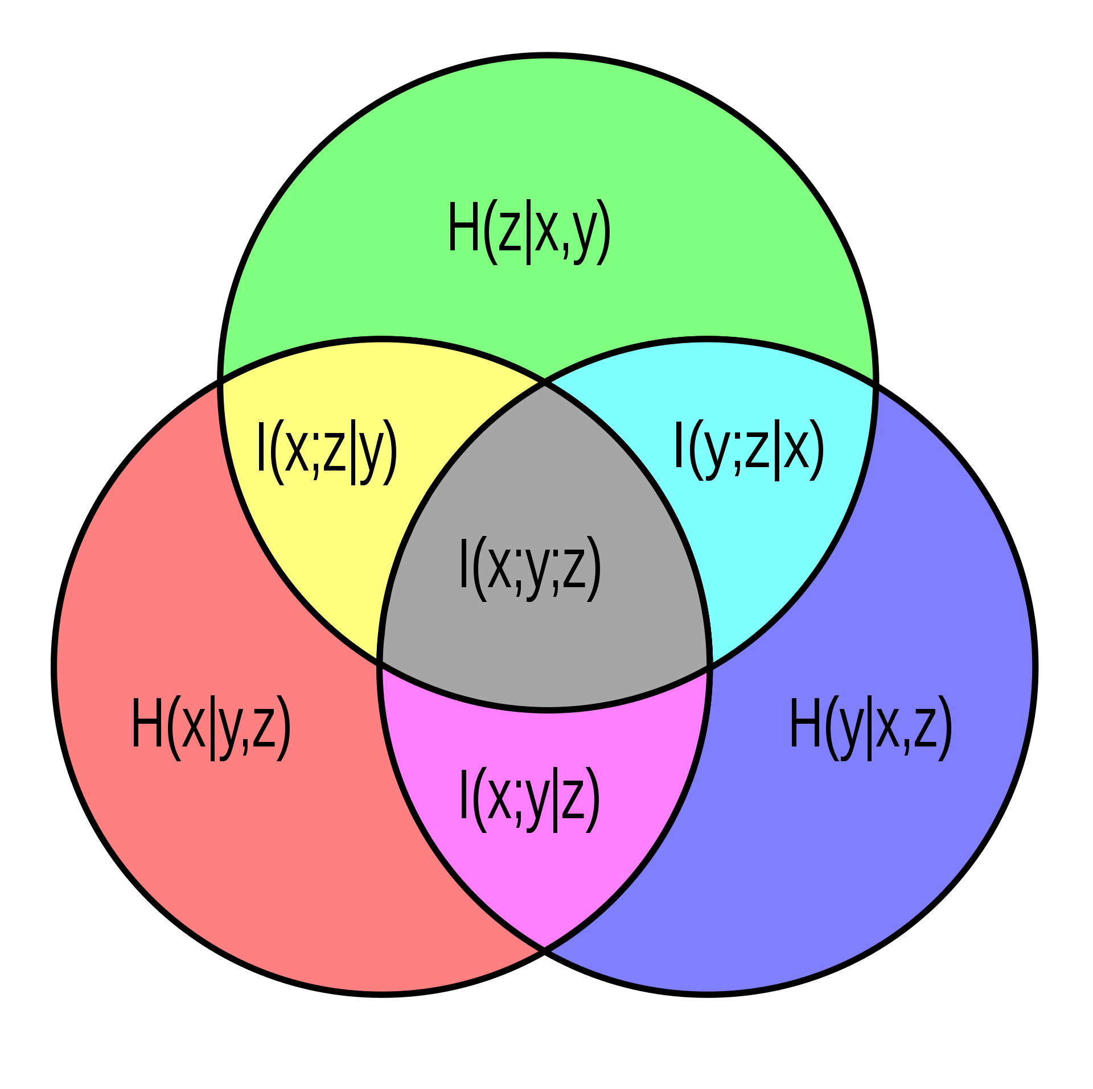
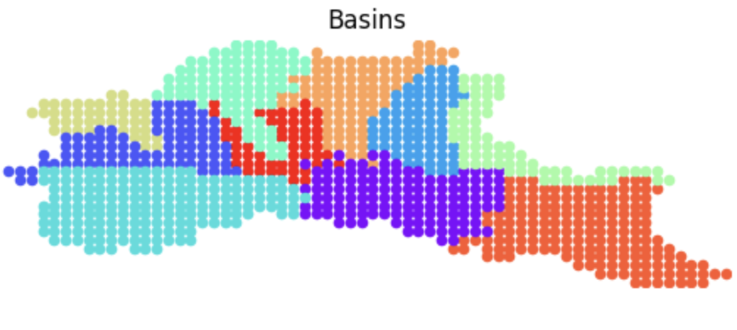
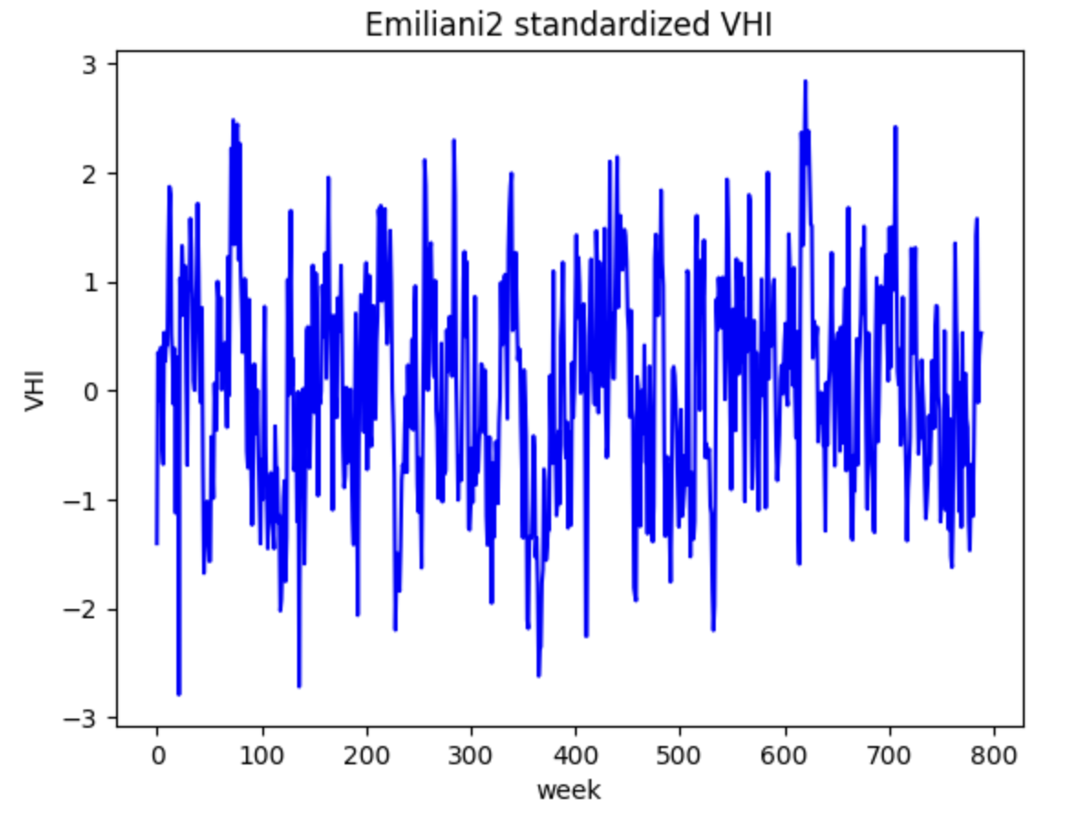
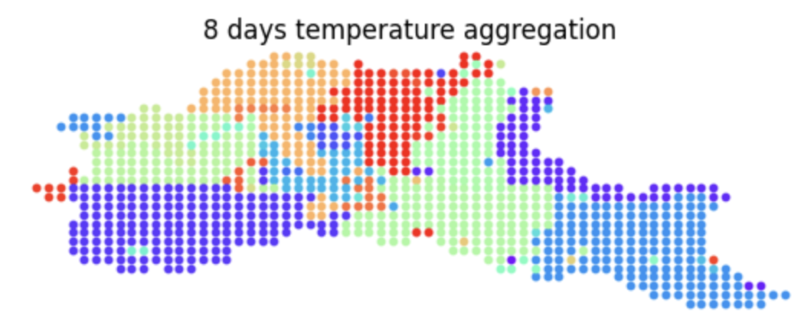
Setting and approach
All variables
Dimensionality Reduction
Reduced variables
Feature
Selection
Relevant variables
Supervised
Learning
Data-driven
EE detection
Samples: 411 train, 228 val, 228 test
Features:
991 pixels of temperature
991 pixels of precipitation
7 aggregations: 8days, 1-4-8-12-16-24 weeks
Target: average VHI of cultivable pixels
Dimensionality reduction
NonLinCFA (mean)
Only neighbours
Only within basin
Only on same feature
(and same aggregation)
From 991*14 to 549 features
Feature selection: CMI (filter, nonlinear)
Regression on 8days VHI
Bivariate classification

Slide 3
Setting and approach
All variables
Dimensionality Reduction
Reduced variables
Feature
Selection
Relevant variables
Supervised
Learning
Data-driven
EE detection
Samples: 411 train, 228 val, 228 test
Features:
991 pixels of temperature
991 pixels of precipitation
7 aggregations: 8days, 1-4-8-12-16-24 weeks
Target: average VHI of cultivable pixels
Dimensionality reduction
NonLinCFA (mean)
Only neighbours
Only within basin
Only on same feature
(and same aggregation)
From 991*14 to 549 features
Feature selection: CMI (filter, nonlinear)
Regression on 8days VHI
Bivariate classification

Slide 4
results
 | Adda | Dora | Emiliani1 | Emiliani2 | Garda Mincio | Lambro Olona | Oglio Iseo | Piemonte Sud | Piemonte Nord | Ticino
Linear Regression R2 score | 0.16 | -0.47 | 0.32 | 0.33 | 0.21 | 0.24 | 0.26 | 0.12 | 0.04 | 0.17
Logistic Regression Accuracy | 0.66 | 0.636 | 0.689 | 0.741 | 0.746 | 0.724 | 0.654 | 0.662 | 0.658 | 0.68
No clear improvement with more complex models (random forest, feedforward neural network)

Slide 5
T2.1, T2.2 progress meeting
POLIMI

